Slide 1
Supervised and unsupervised algorithms for bioinformatics and data science
Karla N Robles
ENCS 6020
Dr. Manar Samad
April 25, 2023

Slide 2
Algorithms covered
Support Vector Machine
Neural network

Slide 3
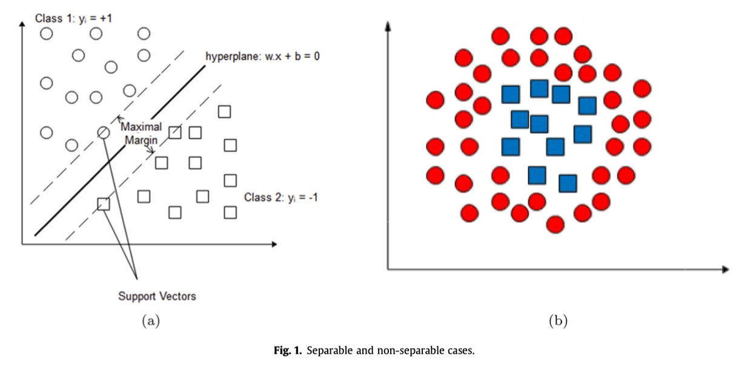
Support Vector Machine (SVM)

Slide 4
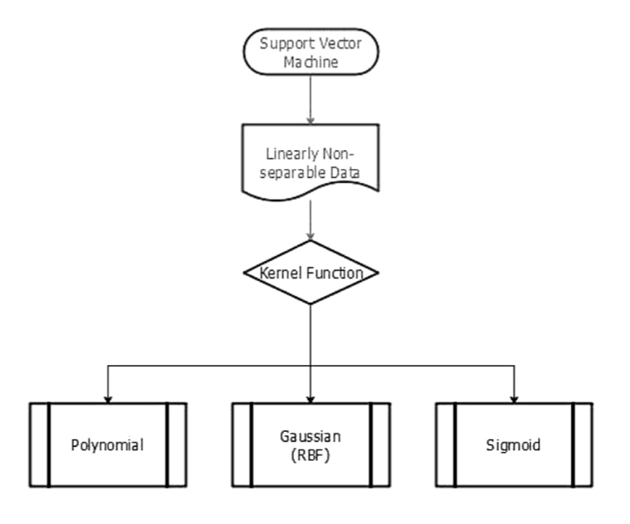
Support Vector Machine (SVM)

Slide 5

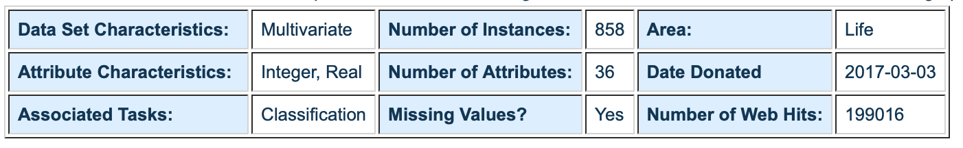
Cervical Cancer (Risk Factors) Data Set

Slide 6
Implementing a Support Vector Machine (SVM) to classify cervical cancer risk factor data
UCI data import
Data curation and manipulation
Initial SVM training
To improve SVM accuracy:
Cross-validation
Principal Component Analysis for feature reduction
Final SVM trained with PCA features

Slide 7
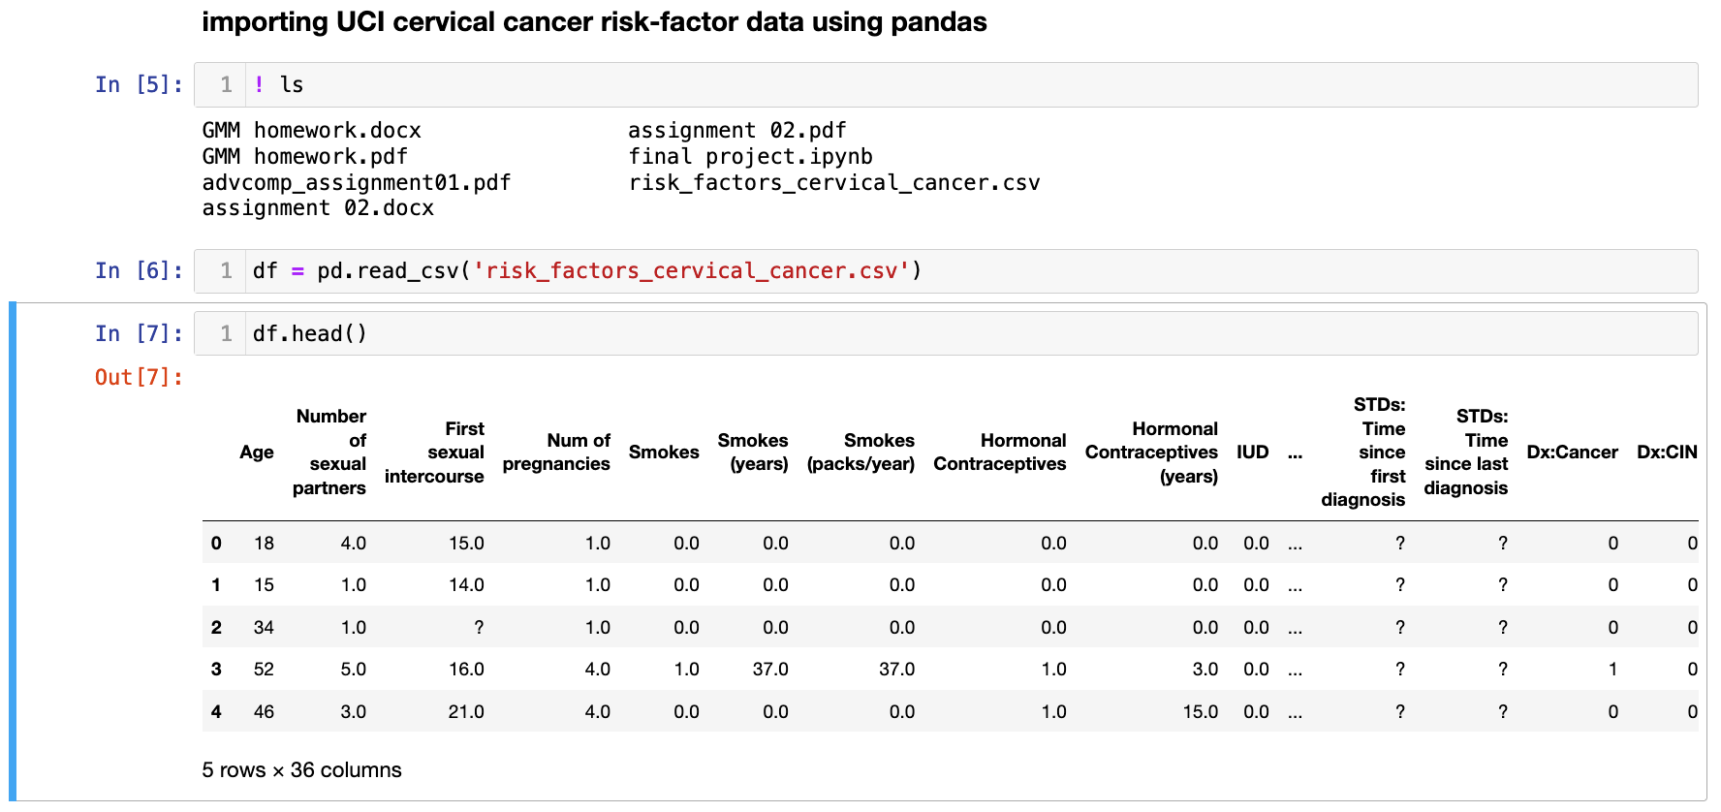
Data import

Slide 8
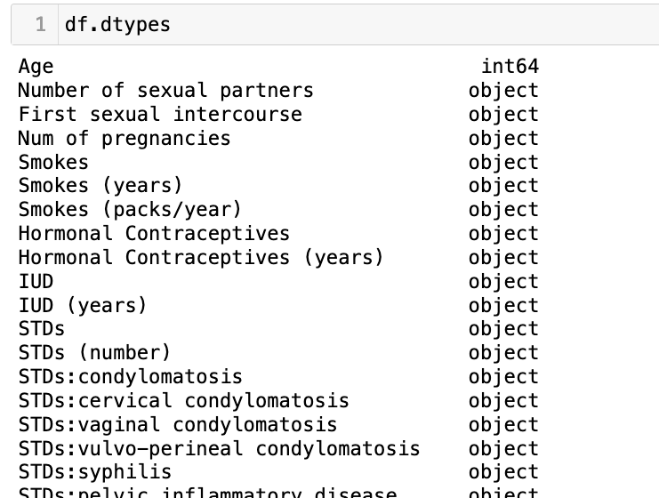
Missing data

Slide 9
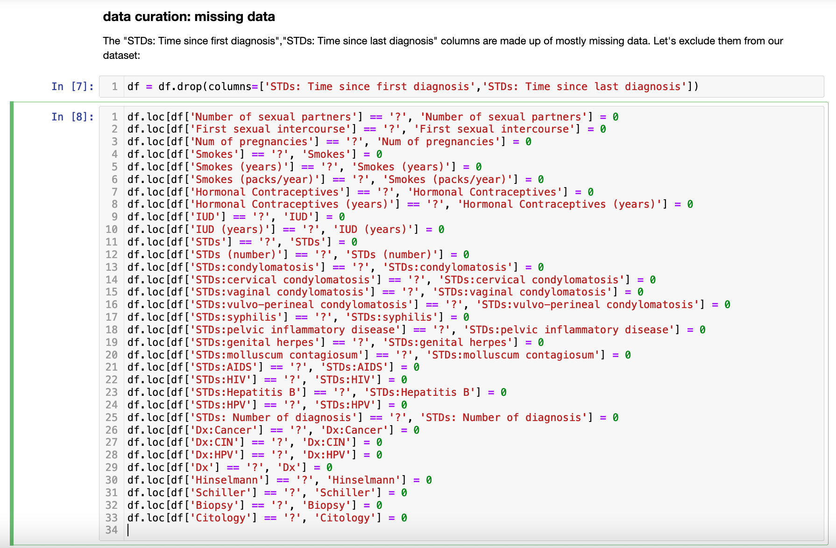
Data curation: dropping columns and substituting ‘?’ for 0

Slide 10
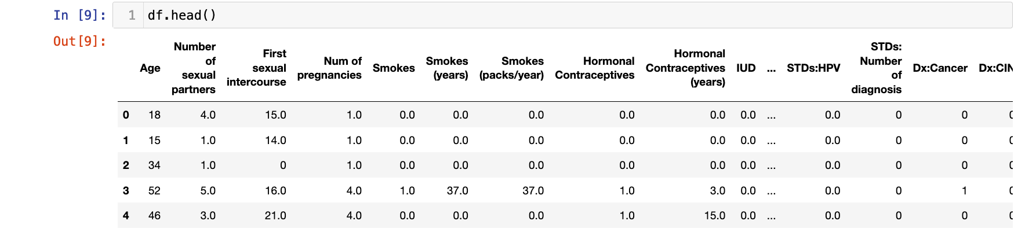
Data curation: dropping columns and substituting ‘?’ for 0

Slide 11
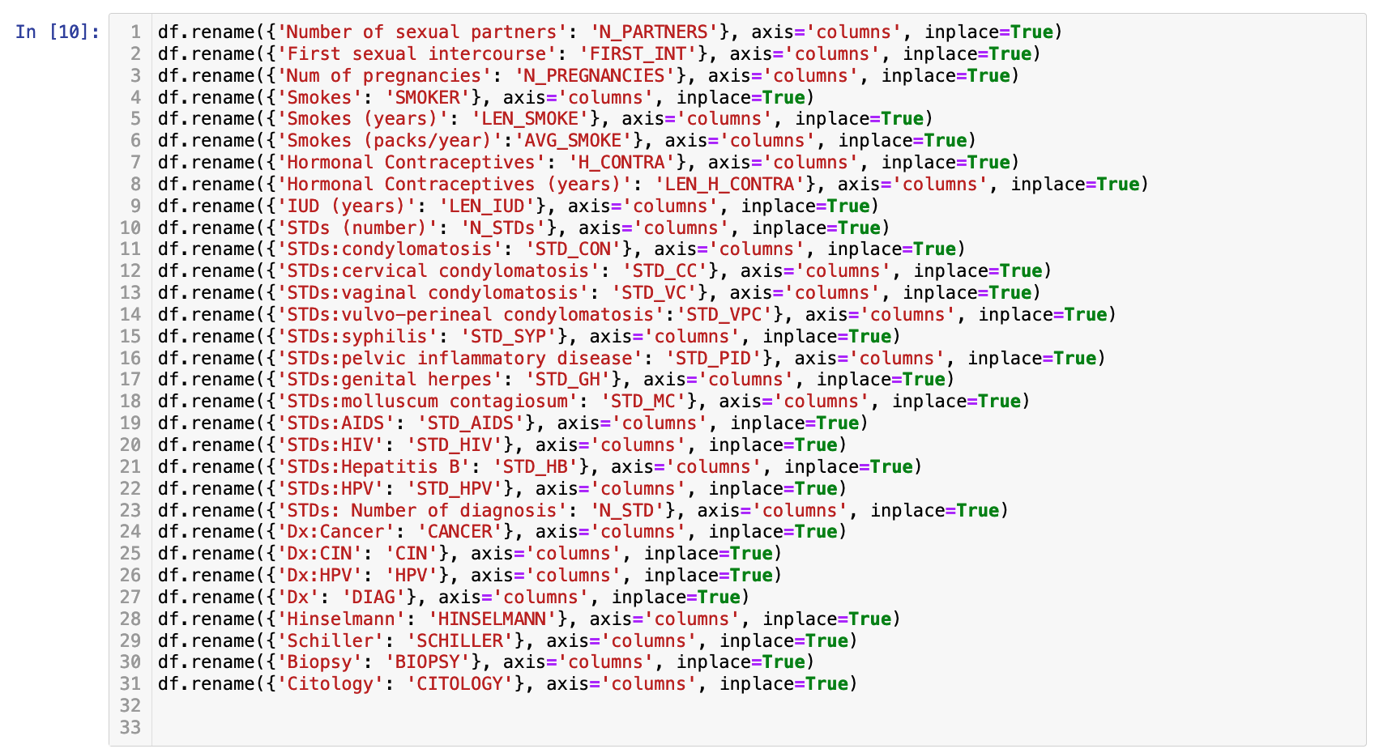
Data curation: renaming columns with lengthy names

Slide 12
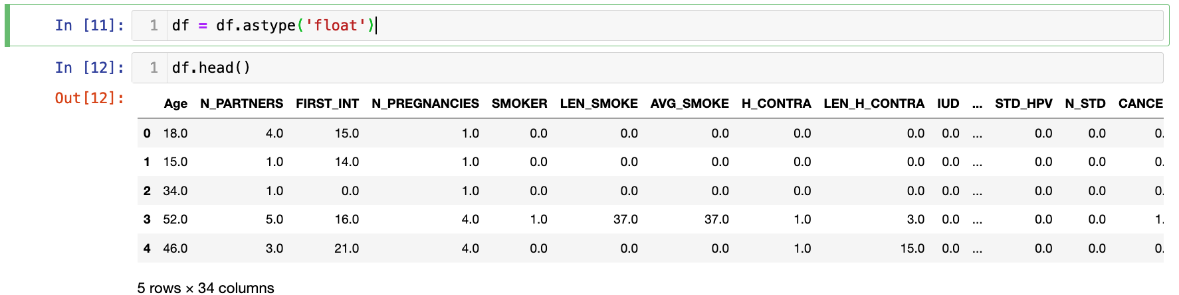
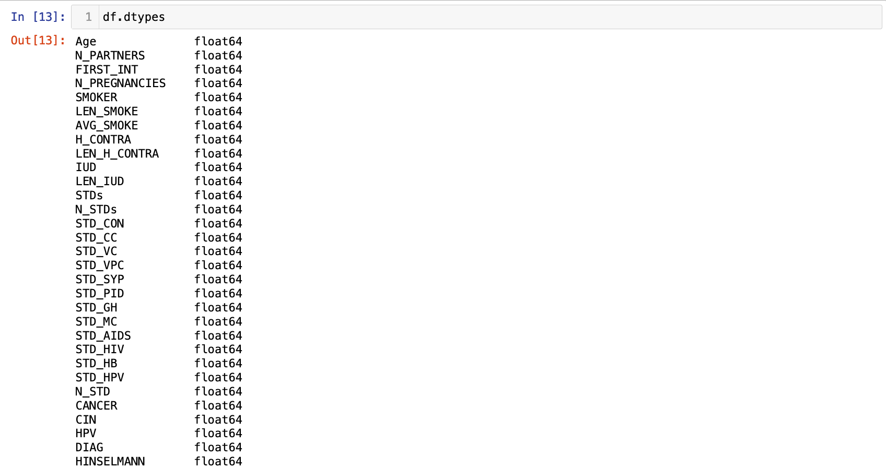
Data curation: casting float data type for all values in the data frame

Slide 13
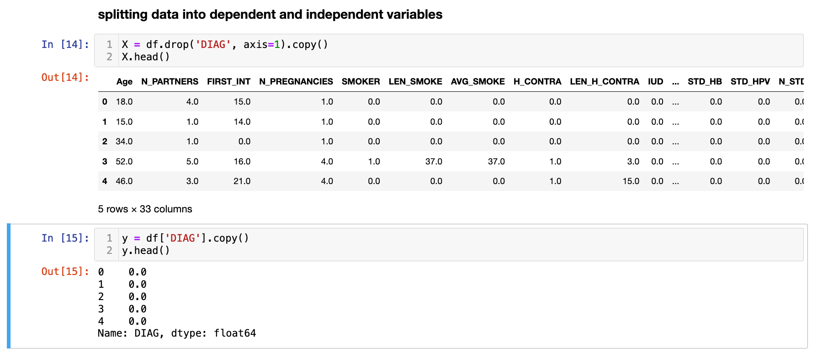
Data splitting into dependent (y) and independent (X) variables

Slide 14
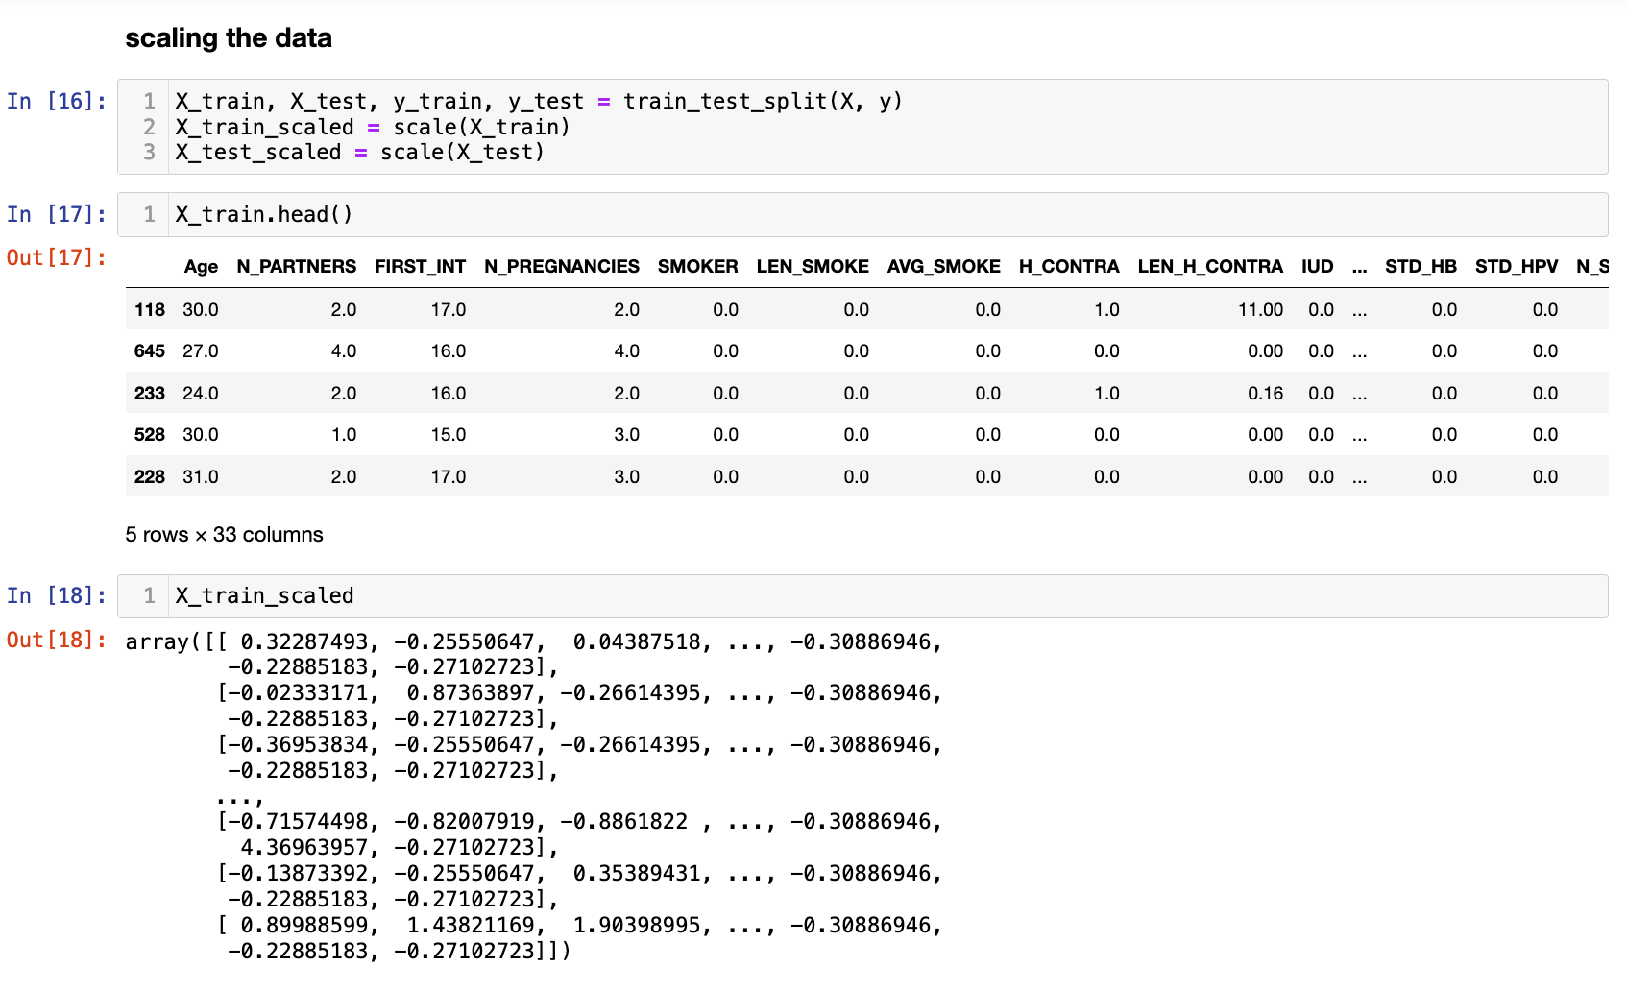
Data splitting into train and test sets, data scaling

Slide 15
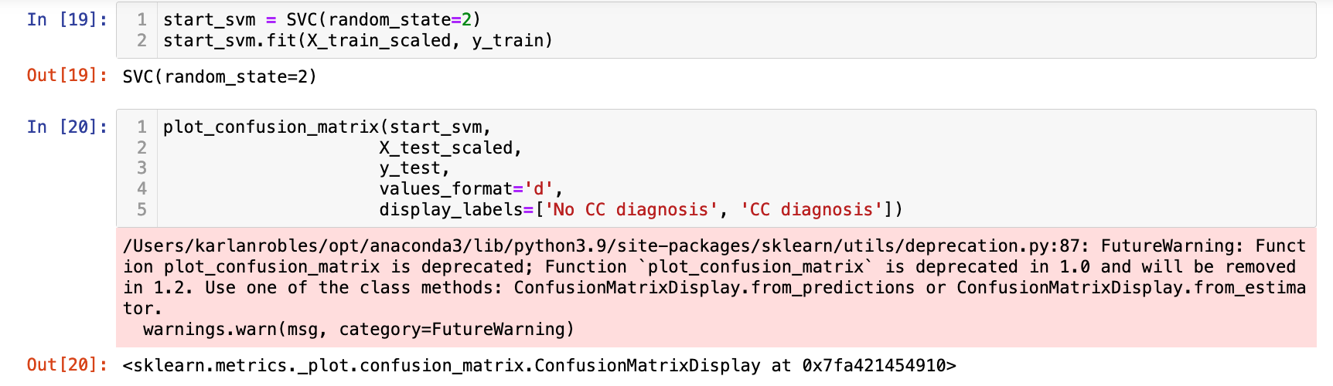
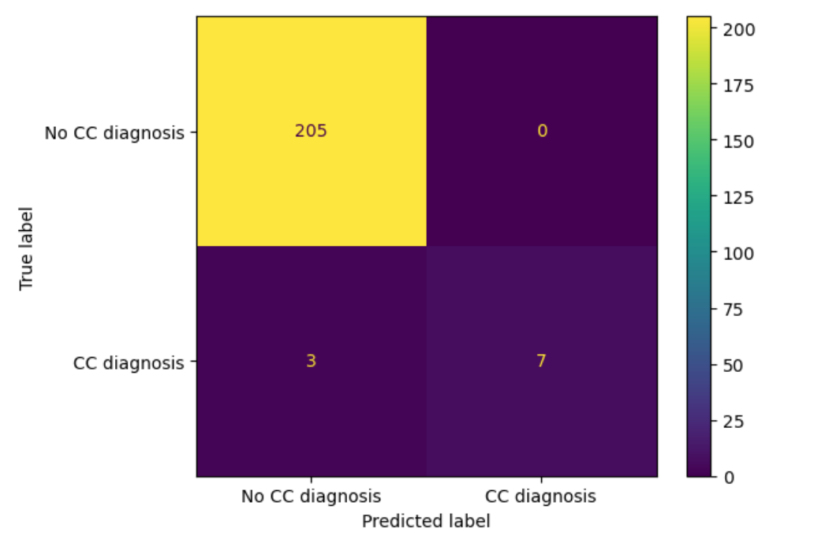
Training SVM and plotting confusion matrix

Slide 16
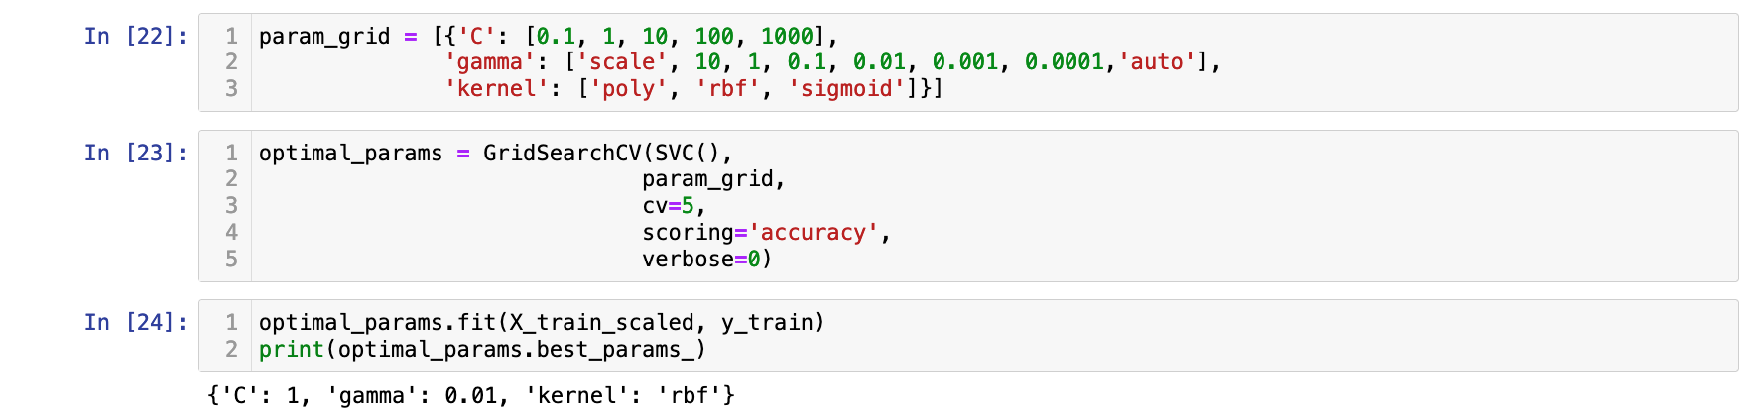
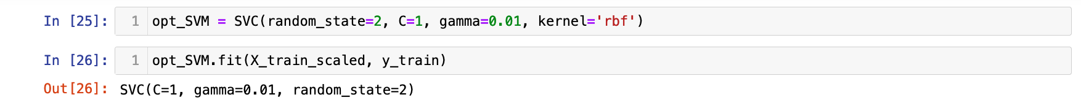
Cross-validation to identify optimal SVM parameters

Slide 17
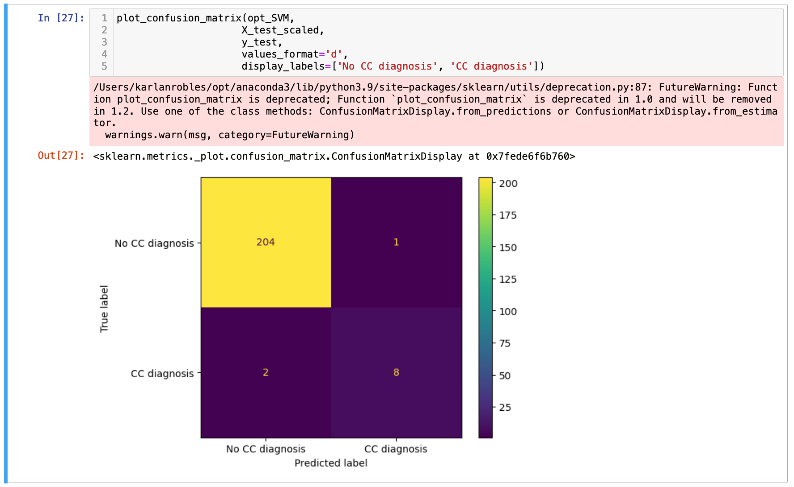
Cross-validation to identify optimal SVM parameters

Slide 18
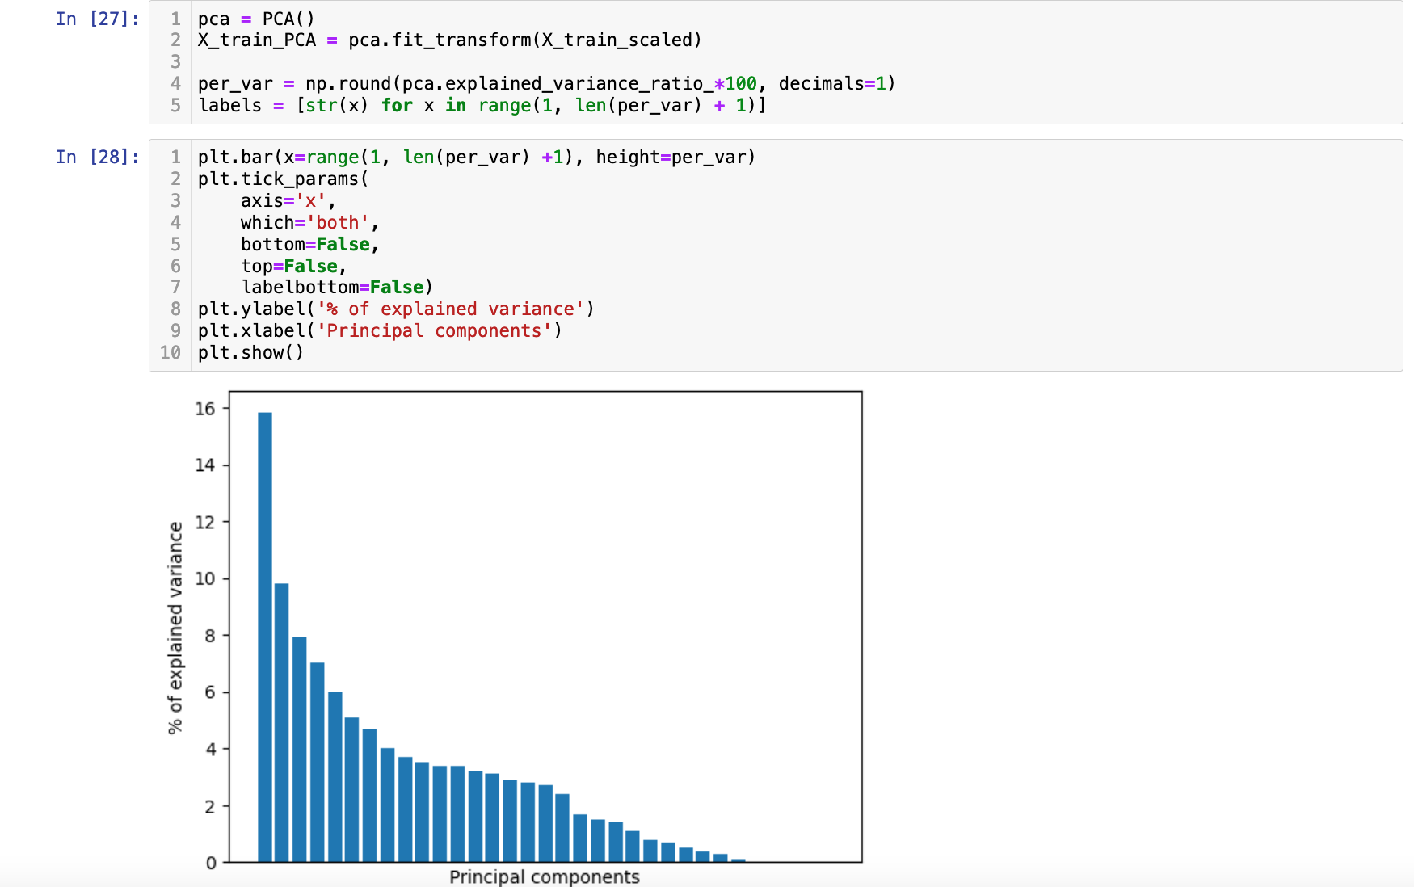
Implementing PCA for feature reduction

Slide 19
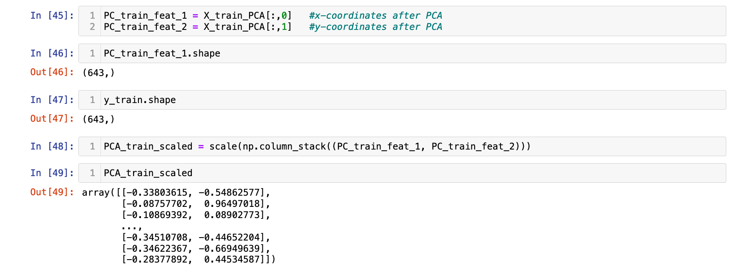
Scaling PCA data

Slide 20
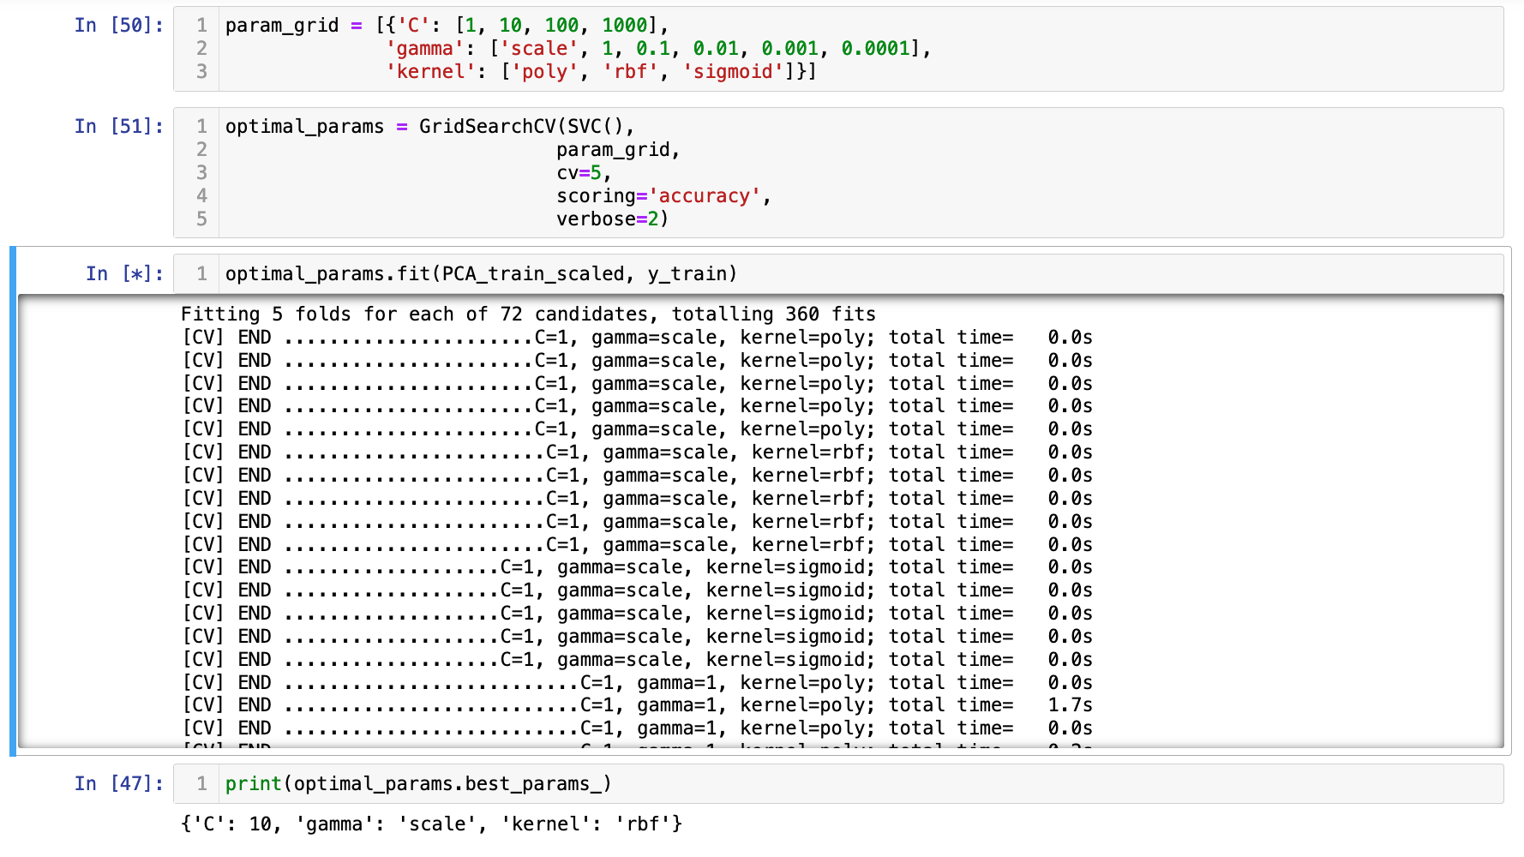
Cross-validation to optimize SVM parameters

Slide 21
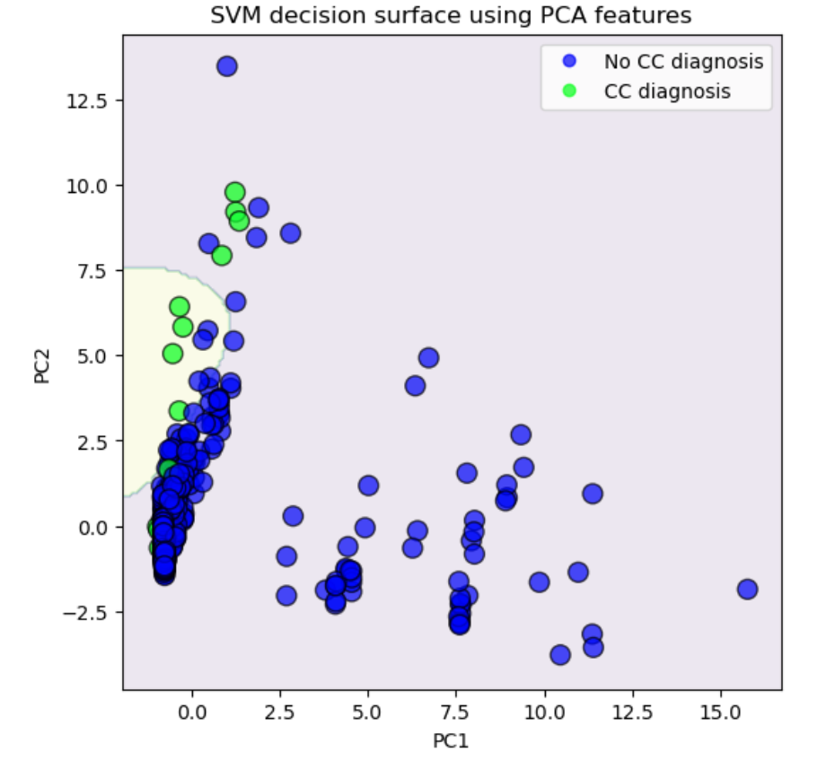
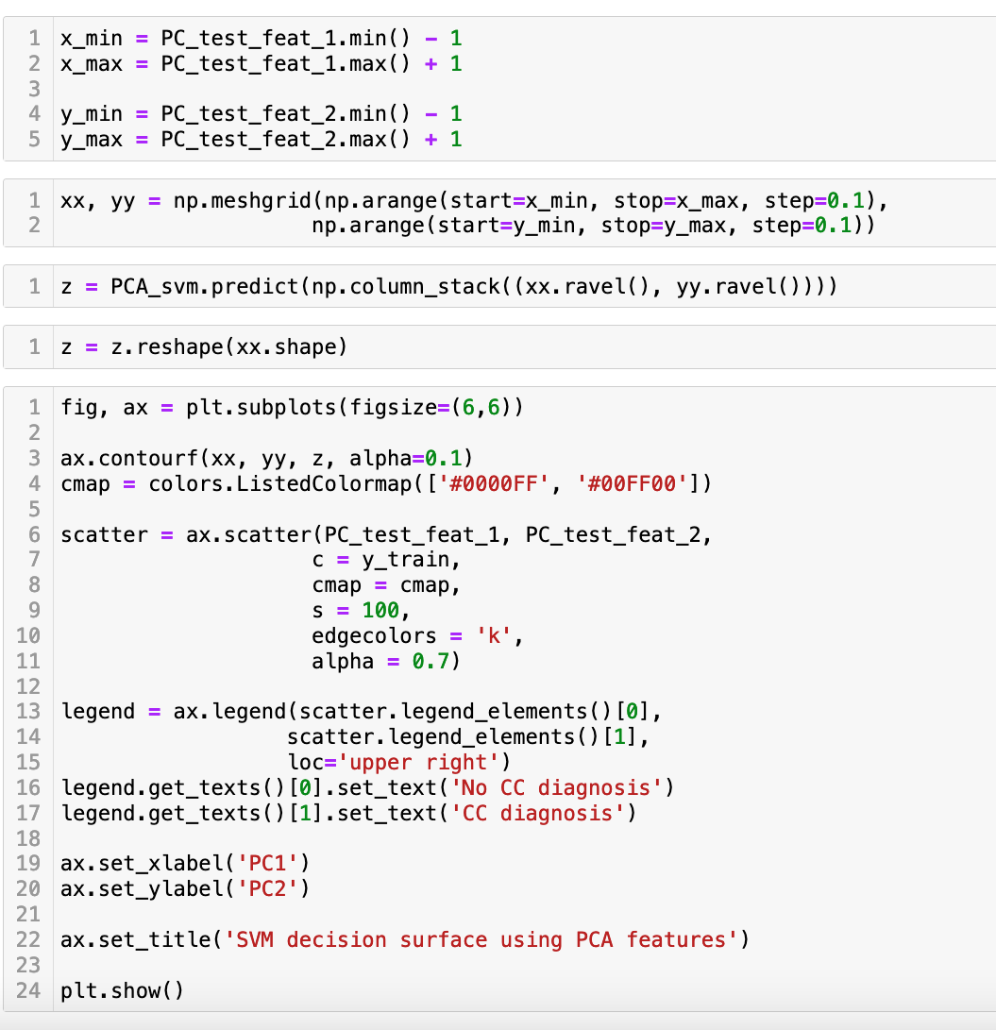
SVM with PCA features

Slide 22
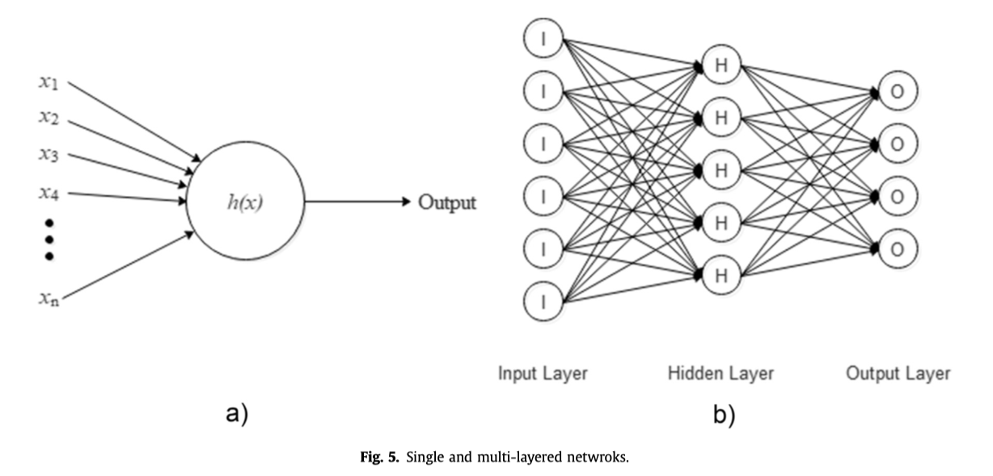
Single and Multi-Layered Neural Networks (NN)

Slide 23
Implementing a Neural Network (NN) to classify cervical cancer risk factor data
Switching from Jupyter to Colab
Data formatting for torch library
Neural net class definition
Train and test functions
Overfitting: MSE vs epochs

Slide 24
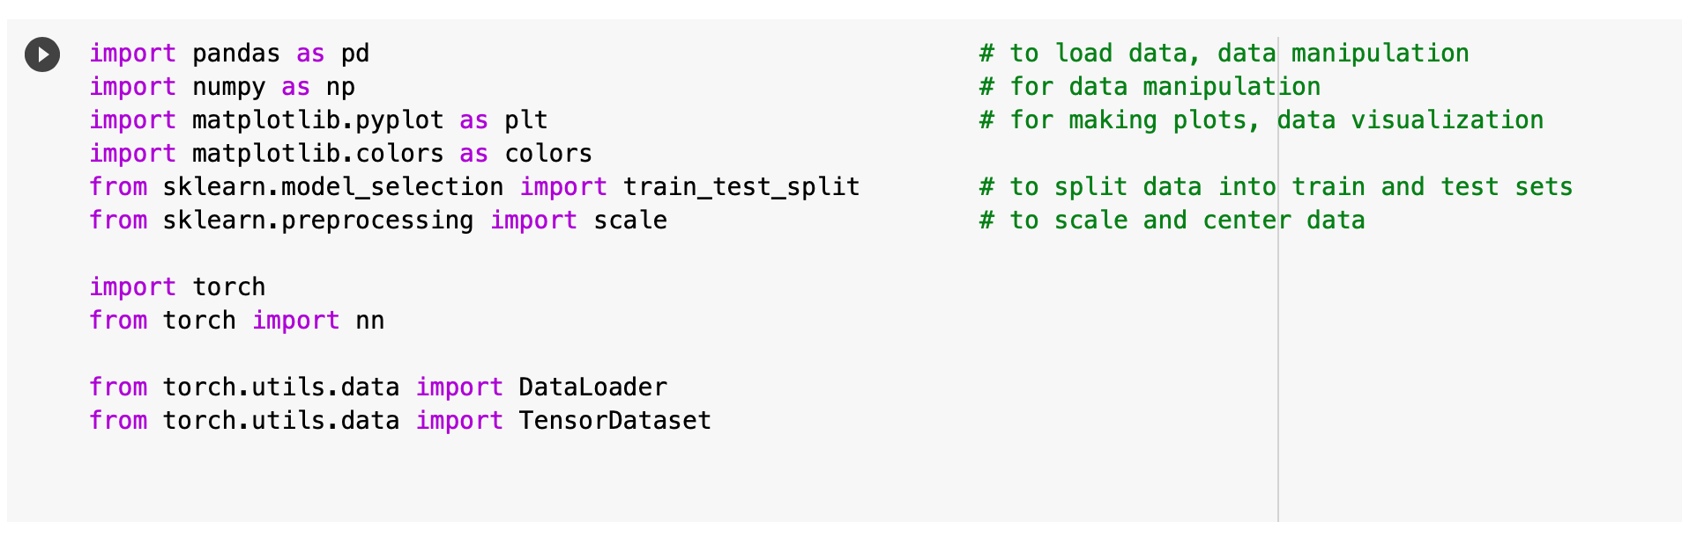
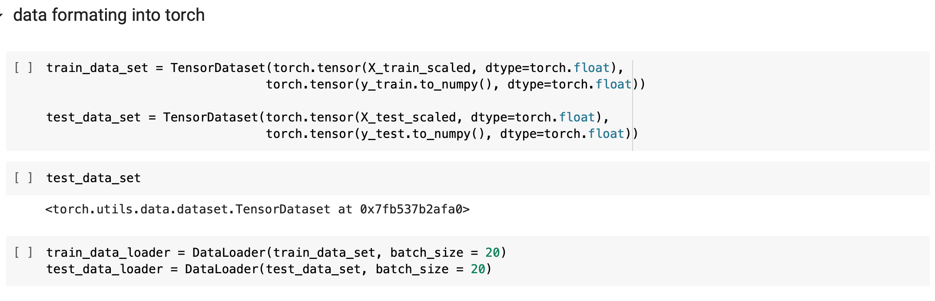
Issues with using torch in Jupyter environment, switched to Google Colab

Slide 25
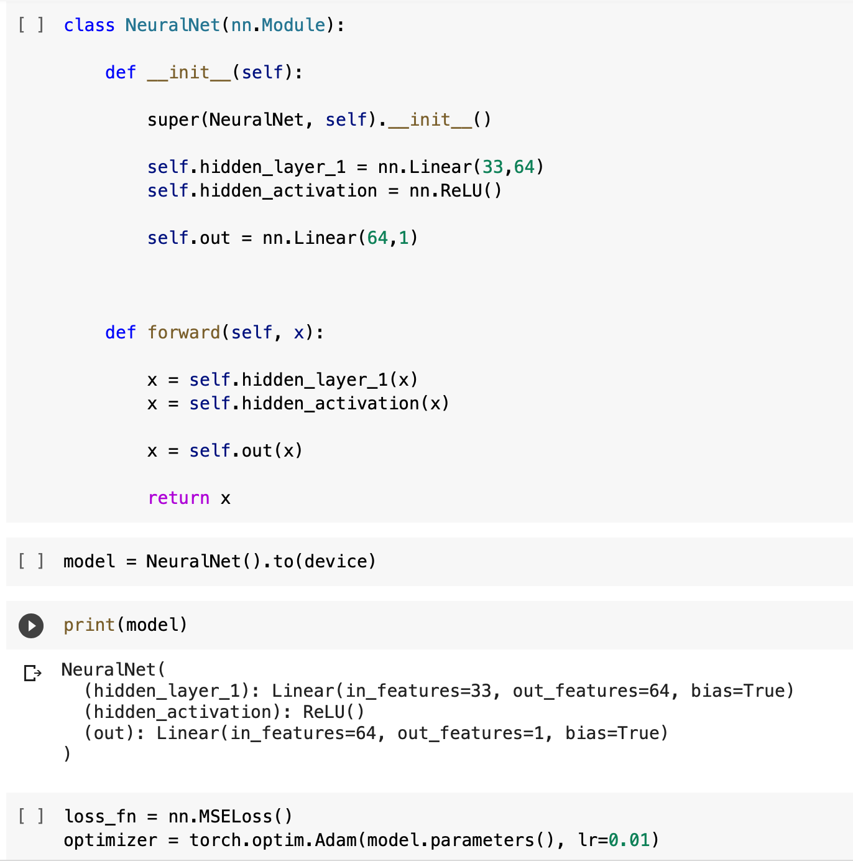
Neural Net class inheritance from nn.Module
nn is a module in the torch library

Slide 26
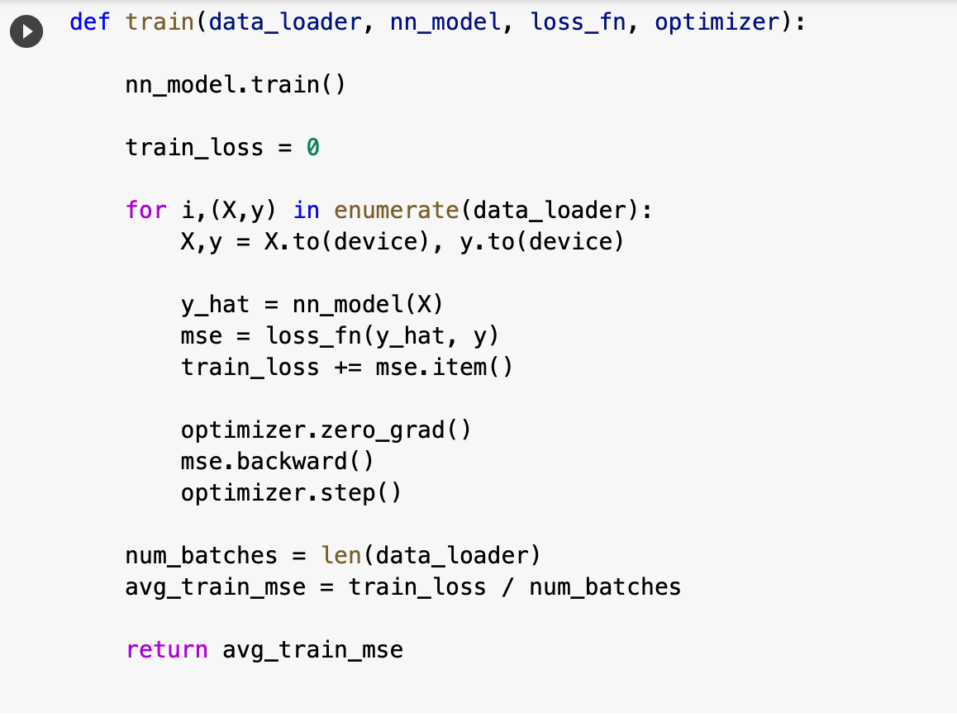
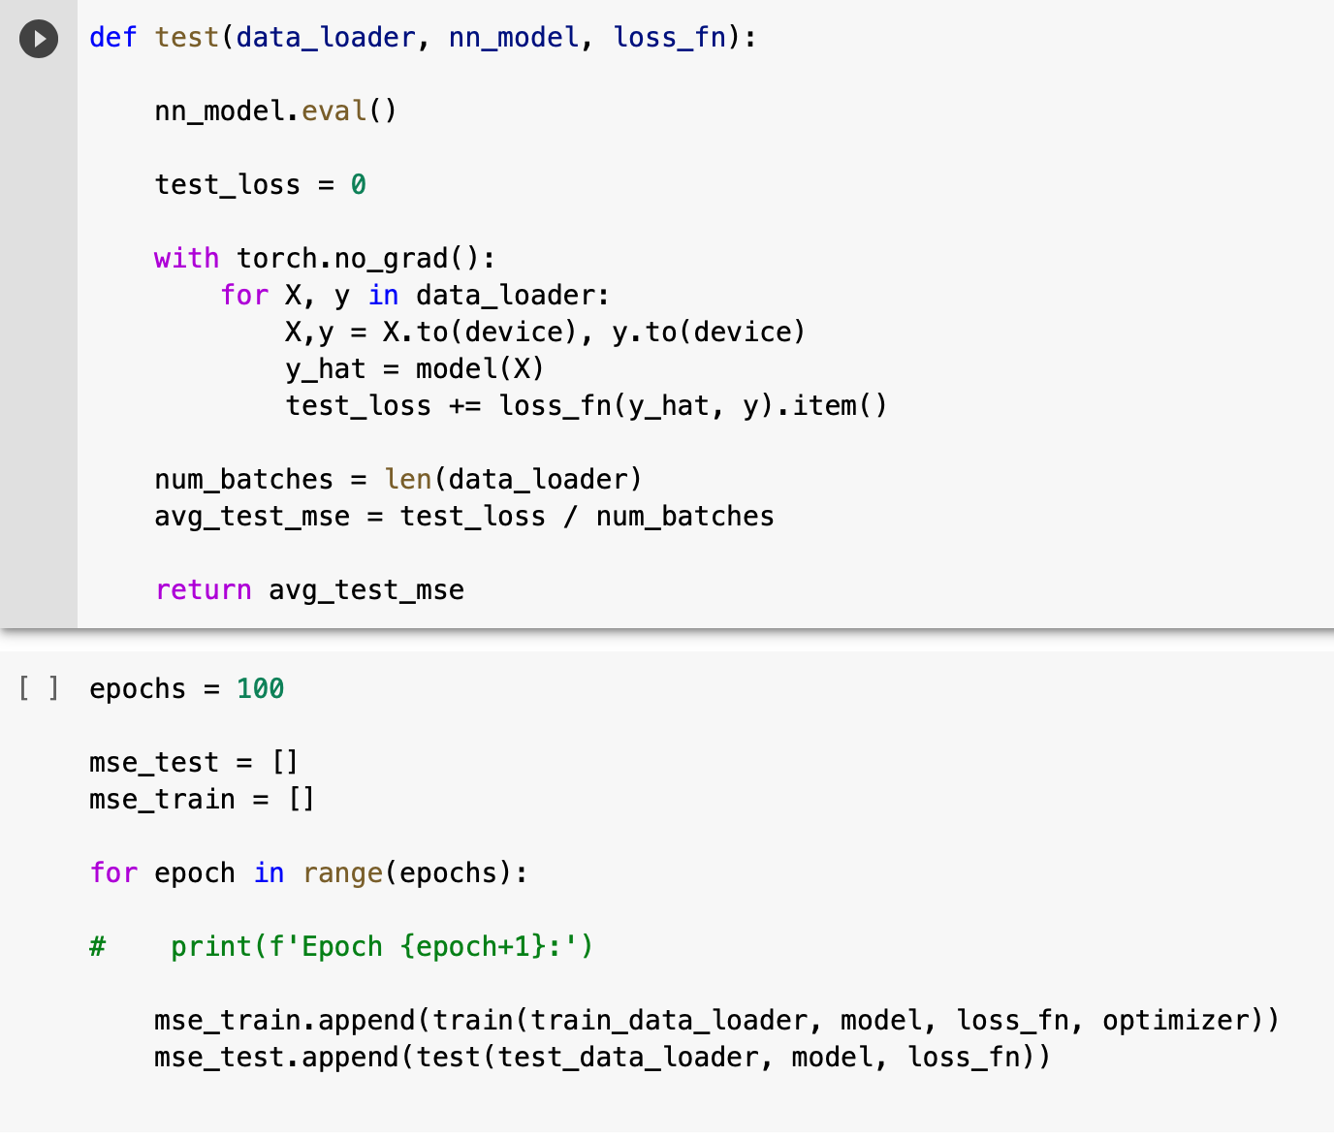
Training and test functions

Slide 27
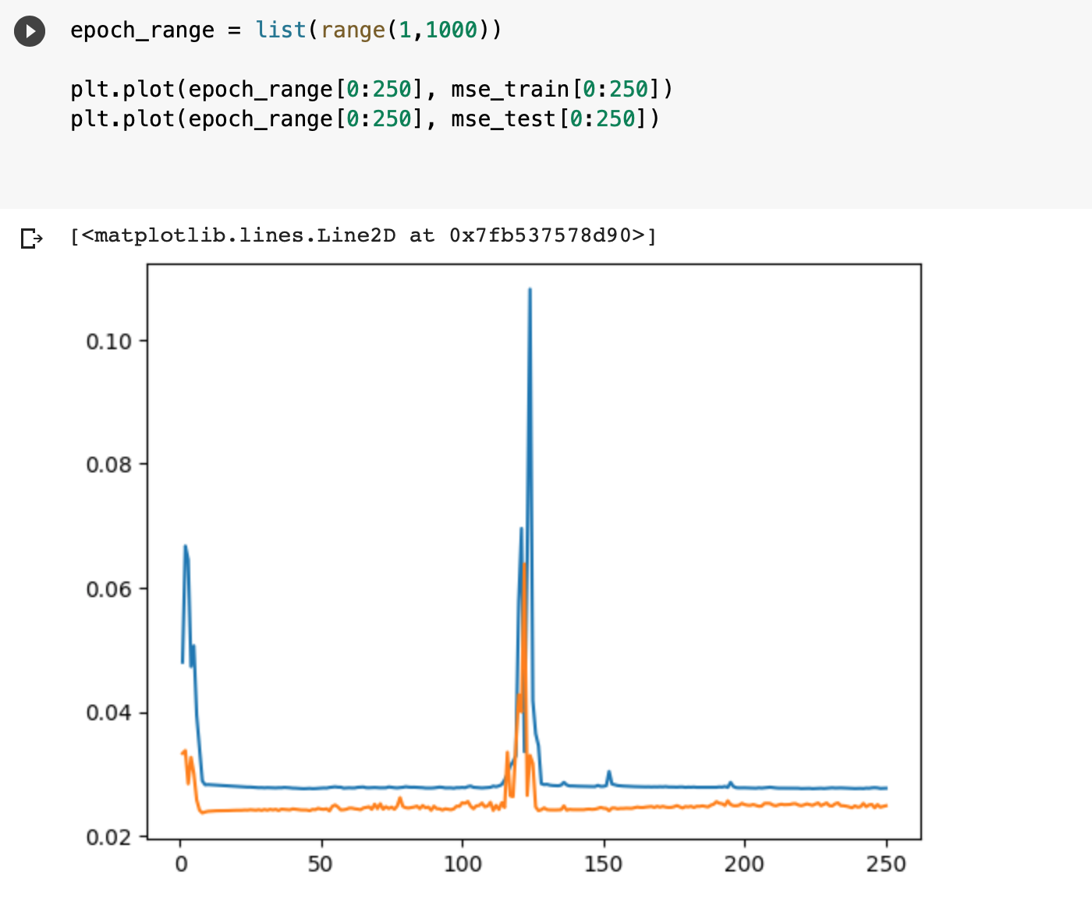
Overfitting: Mean-squared error as a function of epochs

Slide 28
References
https://www.youtube.com/watch?v=SDPeeX6LEnk
https://www.youtube.com/watch?v=8A7L0GsBiLQ&t=4s
Arif and Sohail, Progress in Biophysics and Molecular Biology (2020)

